Slide 1
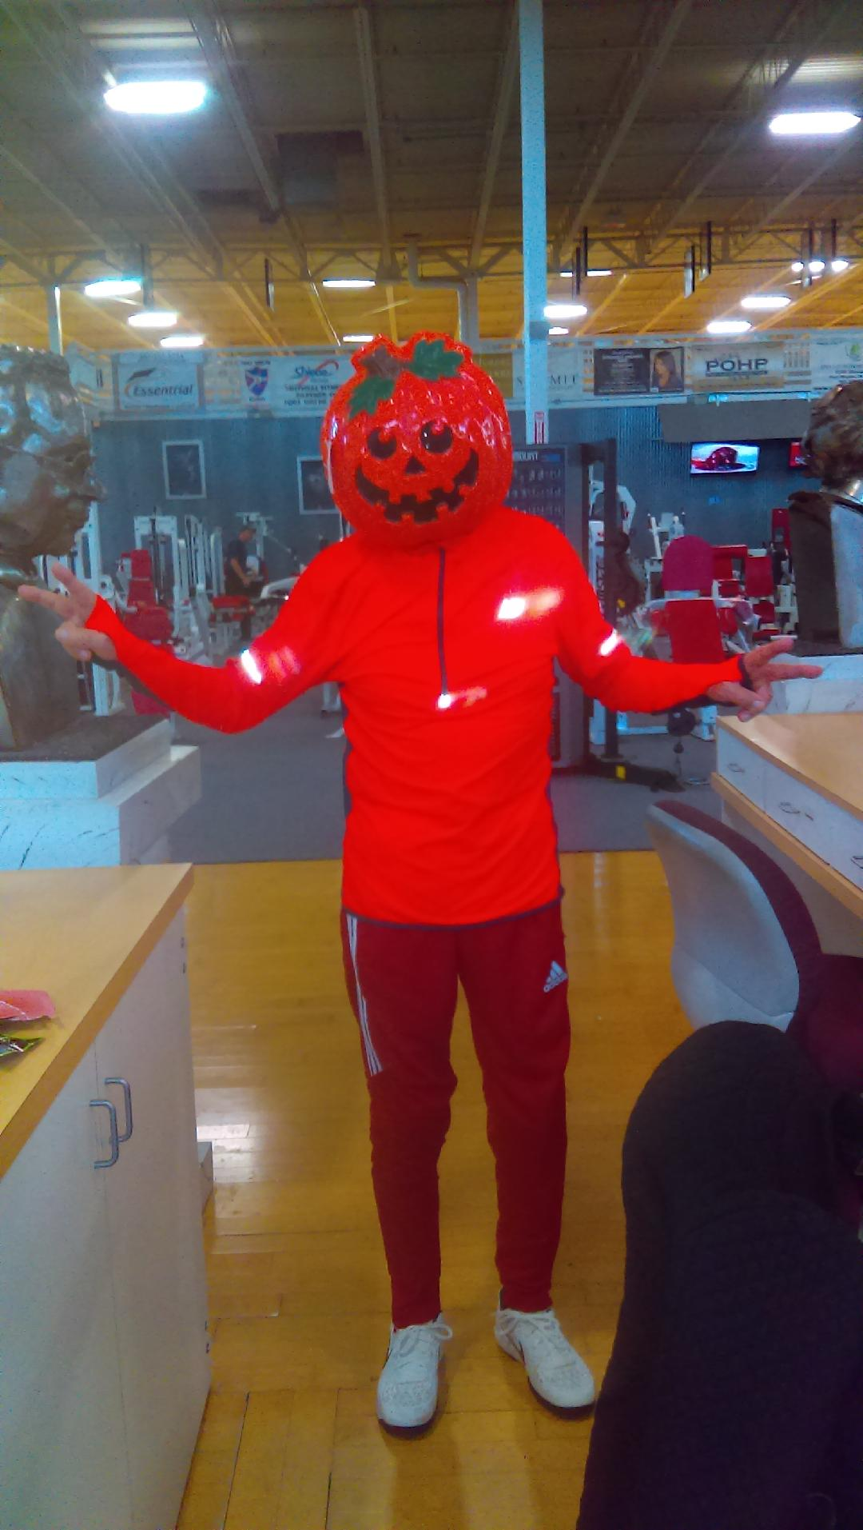
What You Should Know
About Alzheimer’s and Dementia
Dr. Rudy Kachamnn M.D

Slide 2
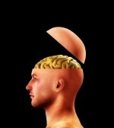
Dementia and Alzheimer’s Disease
What we all fear is losing our mind!
Memory loss, is it normal?
  Age associated memory impairment
  AAMI
  2. SCI Subjective Cognitive Impairment
  3. MCI Mild Cognitive Impairment
Dementia – Alzheimer’s disease

Slide 3
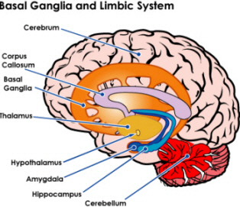
The Secret of Enhancing your Brain
There are about – 100 billion brain cells.
You have 100 trillion synapses.
You lose about 10 to 15% brain cells by age 65
About 1% have advanced dementia by age 65

Slide 4
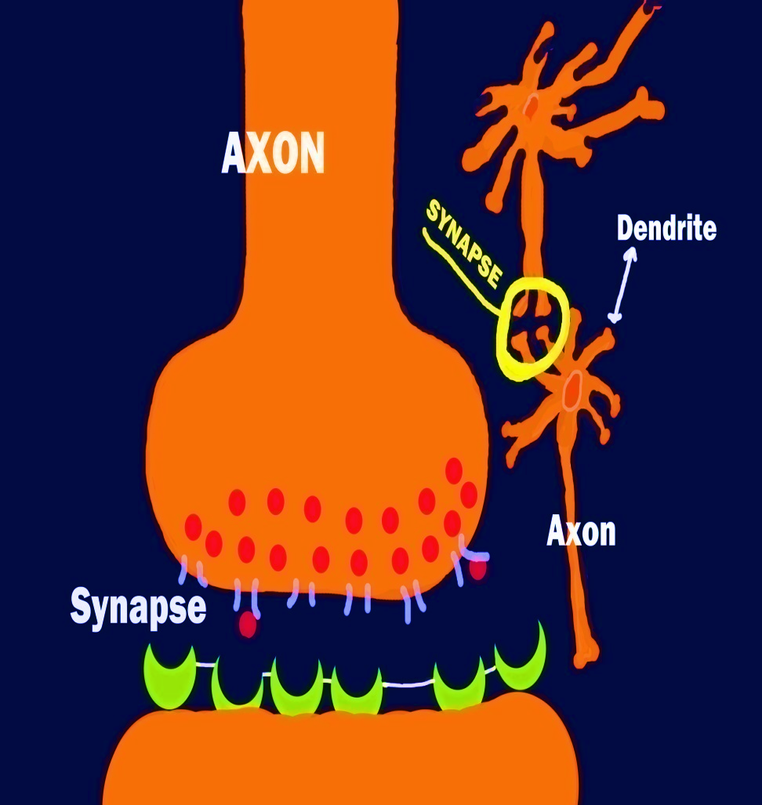
Memory Type
Long term- declarative and non- declarative memory.
Long – term- implicit and explicit memory.
Memory in your Molecules.

Slide 5
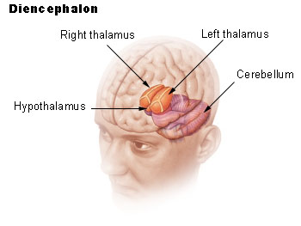
The Brain
How does memory work?
Where is memory located
in the brain?
Physiology of memory
It’s about molecules and neurotransmitters

Slide 6
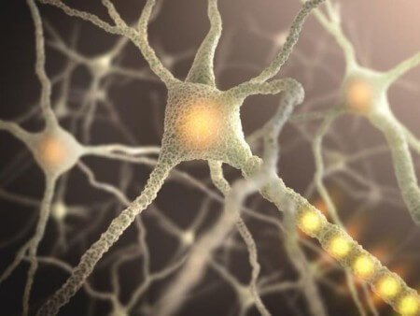
MEMORY
Short and long - term
- different areas of the brain.
Short term – working memory – hippocampus.
Long – term memory – throughout the brain.
Declarative and non – declarative memory
Implicit and explicit memory – long term.
Acetylcholine – memory molecule – nucleus.
(Basalis Meynert)

Slide 7
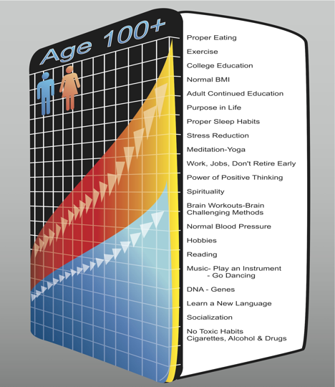
Keep People out of the Gulags
Promote family and
community involvement.
Stop locking everyone up.
Many could live at home.

Slide 8
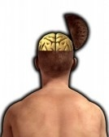
The Patient of the Myth
The fear of memory loss.
Loss of function.
Loss of job.
Living alone.
Depression – I’m useless.
To the nursing home and Alzheimer’s units 1, 2, 3 – the gulags.
Hopeless – I’m doomed – a burdened.

Slide 9
The New Story
  Pick a better name – the Japanese story.
  Tell a more truthful story.
  “A good story is essential to any sense of self worth”
  If you speak a different language, we will tell a different story
  Integrity dignity, personhood, quality of life.
  Community, responsibility for future generations.
  Huge push for prevention – LMBI.

Slide 10
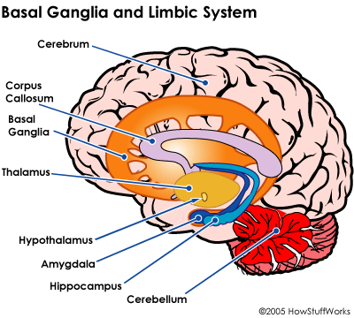
THE HOPE
Fear Brings Torment.
Start a positive scenario.
A different story.
De - emphasize the disease
story.
Set a plan of action.
Memory challenges – we all
have them.
Promote community care giving for elderly patient – not to the nursing home.

Slide 11
The Doctor of the Myth
Invasive test.
PET Scan, C.T. , MRI, and SPECT Scan
Cognitive testing – verbal tests.
“You have Alzheimer’s disease.”
  The Nocebo effect.
Medications – they do little
and cure nobody

Slide 12
Dr. Whitehouse
Spent his professional life in the social, political, and economic and social institutions dealing with Alzheimer’s disease.
Spent his time now challenging the Alzheimer’s community that have great power over us.
Is pessimistic about the future of care for dementia patients – needs to be redefined.
Aging is not a disease.
A natural process.
The scientific technological, and political approach to this war needs to be revisited.

Slide 13
The Myth of Alzheimer’s disease
Dr. Peter Whitehouse
I’ve read it three times, none of my 12 neurologists have ever read it.
25 years in the Alzheimer’s dementia field - Dr. Whitehouse.
Research on the original medicines used today – Dr. Whitehouse.
Help set out the criteria for research and diagnosis – Dr. Whitehouse.
He says the drug essentially don’t work – money wasted and false hope.
He noticed shift from caring potential to medicines that don’t work.
Many times only pills are given and the patients are locked up.
Dr. Whitehouse says it’s inhumane and inexcusable.

Slide 14
The Fraud
You cannot separate Alzheimer’s disease from normal processes – so how can treat it or study it?
Scientists in the field admits that a cure is unlikely.
We don’t know for sure, what really causes it.
A very powerful cultural myth.
Like war – the pharmaceutical and industrial complex at work.
The research and industrial complex at work.
The fund raising societies at work – fundraisers without results.
Much profit to be gained by everyone – including nursing home.
Research institutions and advocacy groups are spending a lot of money without results.

Slide 15
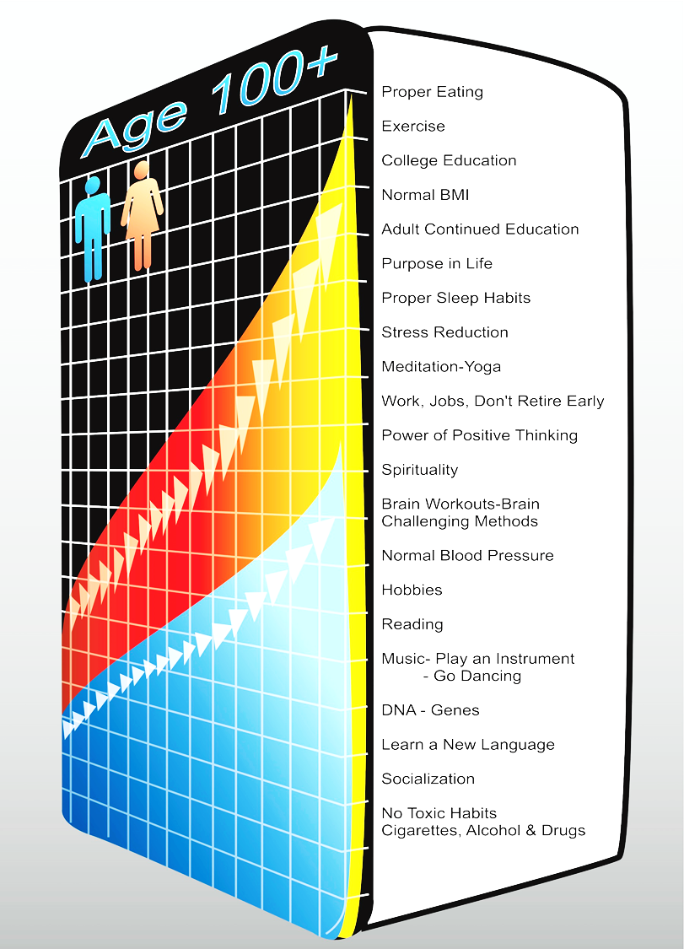
LONGEVILITY
Mind Body Index
Dr. Rudy Kachmann

Slide 16
The Secret of Enhancing the Brain
90% who think they have dementia, don’t.
Depression – big problem
very common.
The mythology of Alzheimer’s disease.
Living into the role

Slide 17
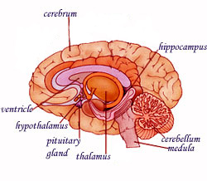
Protect Your Brain from Injuries
Poor cognition.
Boxing and soccer
– dangerous to your brain.
Increased dementia.
Tears long axons.
Decreases neural transmitters.
Smaller brain reserve.
Increase amyloid and neuro – fibrillary tangles.

Slide 18
The Power of Choice.
Love-not fear and anger.
Quality time-holding hands, music, walks and friends.
Love triumphs over the myth.
Plato-limit the doctor's power over us.
The biomedical view is too strong.
Exposing ourselves to the tyranny above us.
Clearly it can be a struggle for the caregiver, but a positive viewpoint is helpful.

Slide 19
The Power of Choice.
We are more than the sum of our cognitive decline.
There is no loss in self-only change in self.
Rewrite the story and reduce it to its bare bones-like Rene Descartes did in 1650.
Cognitive loss is part of humanity, not a disease.
Oprah, she asked Dr. White House three times-where is the beef?
Michael Fox story.
Brain aging cannot be cured-choose your story.
The flame will go out for all of us-go down in the spirit of love and celebrate life.

Slide 20
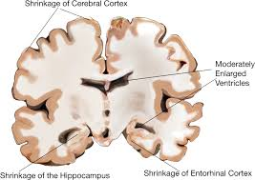
Aging Brain
Brain cell loss doubles every five years after age 65.
Memory loss-aging brain.
Age associated memory loss-AAMI.
Mild cognitive impairment-CMI.
Dementia, advanced dementia-A.D

Slide 21
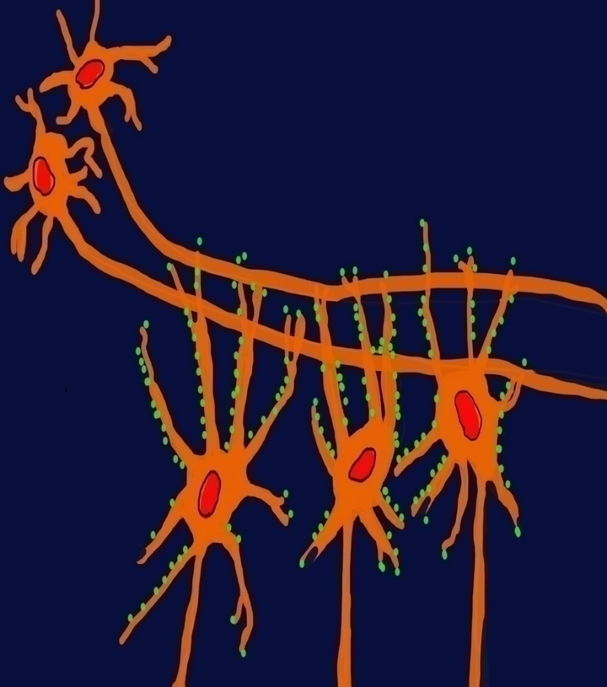
EXERCISE
Increases Memory.
Decreases advanced Dementia.
BDNF-Brain derived neurotrophic factor- increases with exercise
Socialization.
Don't retire.

Slide 22
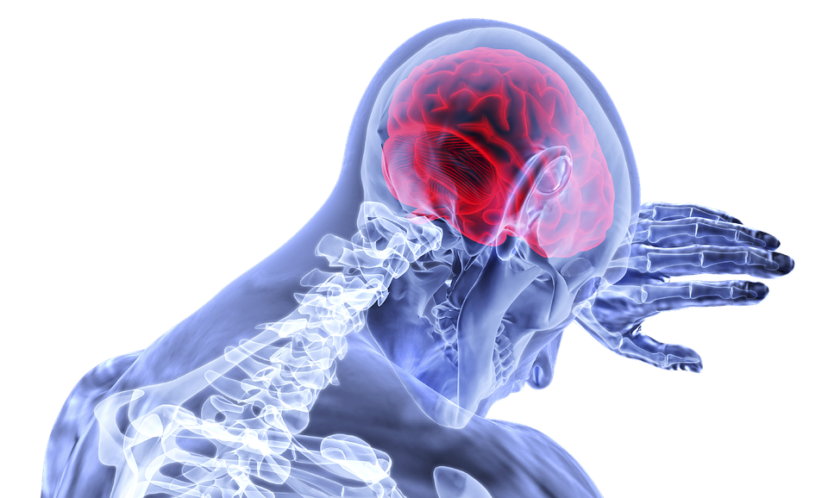
Beware of Depression
Chronic stress and depression toxic to memory.
Difficult to diagnose.
Loss of energy and appetite.
Loss of self-esteem.
Isolation.
Stop exercising.

Slide 23
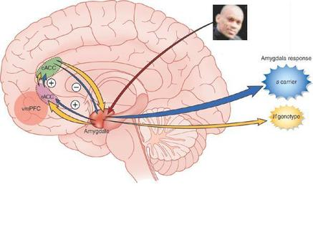
Memory Tricks
Look, snap, and connect.
Repeat frequently-encodes
memory.
Take notes.
Visualize-very helpful.
Good night sleep.

Slide 24
Improving Working Memory
Why do Telephone numbers have seven digits?
Tried to memorize 10 digits to improve memory.
Break numbers into groups-called chunking.

Slide 25
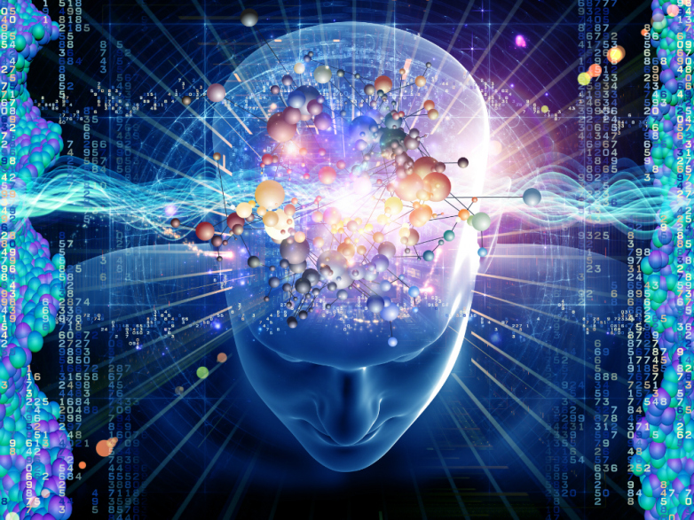
SUPER POWER BRAIN
Education.
Attention to sensory expression
using your five senses.
Memorize poetry.
Attach emotions to your important
memories.
Read "the secret of the Non Diet“
-proper eating-fat is the enemy of the brain.
Use visualizations to improve your memory
-visualize and encoded it.
Vitamin E and C
Omega-3.
Fruits and vegetables.
Fresh and natural foods.

Slide 26
Improving Working Memory
Name 20 to 30 animals.
Draw different designs for improvement of visual memory.
Expand vocabulary-one word per day-see website.
www.wordsmith.org-receive one word by e-mail every day.

Slide 27
Living in the Role
The Nocebo effect of words-watch out.
Your choice-perception.
Standard myth is too negative.
Medicalization of dementia.
Brain aging is not a war.
Don't create “non people”
Don't project hopelessness onto people.
Life is like a flame-Buddhism.

Slide 28
Technology Improves the Brain
Astounding brain enhancement, and verbal and nonverbal intelligence.
After one hour of video game playing.
POGO.com-free video games.
Clearly powerful tool-slowing,, stopping and even reversing age-related memory loss.
Video games are unique in increasing processing speed.

Slide 29
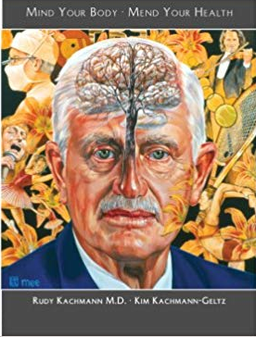
BRAIN GYMS
Pogo.com
Luminosity.com
Mindfit.com.
Kachmannhealth.com

Slide 30
The Neuro Plan
Dean and Ayesha Sherzai, M.D
Risk assessment
Neuro Plan
Nutrition
Exercise
Unwind
Restore
Optimize

Slide 31
Top 20 Brain Foods- Smoothie
Avocados
Beans
Blueberries
Broccoli
Coffee
Dark chocolate
Extra virgin olive oil
Flaxseed
Herbal tea
Herbs
Leafy greens
Mushrooms
Nuts
Omega 3 fatty acids
Guinoa
Seeds
Spices
Sweet potatoes
Tea
Turmeric
Whole grains

Slide 32

Top 10 Foods to Avoid
Processed foods – chips, cookies, etc.
Processed meats
Red meat
Chicken
Butter and margarine
Cheese
Fried food and fast food
Pastries and sweets
Sugary drinks
Excessive alcohol

Slide 33
Seven Stages to Dementia
Stage 1 : Pre clinical – 20 years
occasional forgetfulness
Stage 2: Mild decline – 20 years
occasional forgetfulness – others may notice
Stage 3: Mild cognitive impairment – 1 to 3 years – MCI
1. Forgetfulness noticed by others
2. Anxious – at work
can still daily activities
Stage 4: Mild to moderate dementia
Difficulty driving aggressive, withdrawn
Difficulty with finances
Stage 5: Moderate to severe dementia – 1 to 2 years
Stage 6: Severe dementia
Unable to do daily activities
Stage 7: Final stage – 1 to 2 years
needs help daily activities

Slide 34
Better Brain Solution
Dr. Steven Masley
Brain – Blood Sugar – Heart connection
Boost your brain with 12 smart foods
More ways to feed your brain
Key nutrients for brain health
Move for a better brain
Calm your brain
Smoking, alcohol marijuana – obesity shrink the brain
Nourish your brain

Slide 35
What Causes Dementia?
Dr. Masley
Insulin resistance and elevated blood sugars
Cardiovascular diseases
Inactivity
Nutrient deficiency
Toxins – alcohol, smoking
Stress
Inflammation
Hormone imbalance – menopause and andropause
Depression and anxiety
Genetics

Slide 36
Activities to Build Cognitive Reserve
Learn new language
Learn a new instrument
Computer programming
Write a book
Karaoke singing
Performing, stand up comedy
Learn to dance
Chess club or group card games bridge, gin, poker
Volunteer to teach, give lectures
Painting – arts
College courses

Slide 37
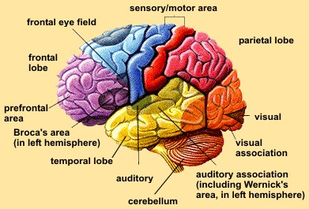
Aim To Eat These Foods Everyday
Green leafy vegetables
Other vegetables
Omega 3 rich sea food
Olive oil
Nuts and other healthy fats
Berries and cherries
Cocoa and dark chocolate
Green tea and coffee
Red wine
Herbs and spices
Beans
Fermented foods

Slide 38
End of Alzheimer's
Dr. Dale Bredesen, M.D
Cognoscopy – Where do I stand?
Recode – reversing cognitive decline
How does it feel to come back from dementia?
Detailed Science of Dementia and Alzheimer’s
Dr. Bredensen
Amyloid
Neurofibrillary temples
Sugar the booger
Dr. Schilling – IDE enzyme

Slide 39
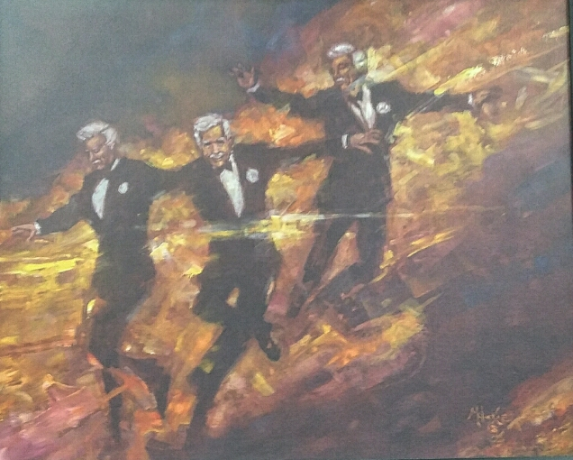
THE END

